Slide 1



Introduction to the Mobile App for Gospel TV
Welcome to an unparalleled experience in accessing gospel content. Discover an app designed to bring the word of God to your fingertips.
Da
by Duncan Kitune

Slide 2

Problem Statement
Christians worldwide face difficulty in connecting with gospel TV stations, often limited by location or accessibility.
1
Regional Limitations
Content accessibility is often geographically restricted.
2
Availability
Traditional cable or satellite services may not carry gospel channels.
3
Technology Gap
Varied user technology fluency presents a challenge in consistent access.

Slide 3
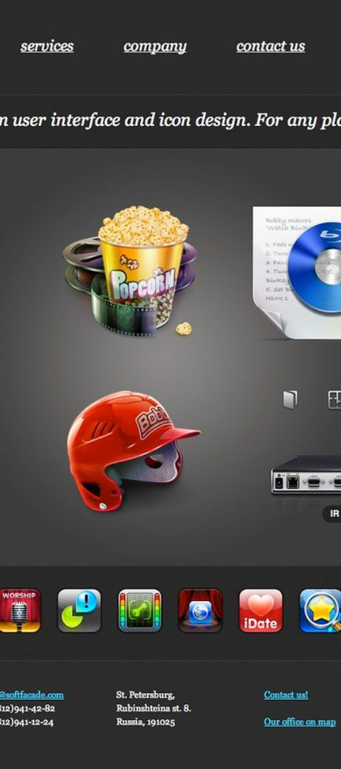
Solution: App Features
Our mobile app integrates groundbreaking features that enhance your gospel media consumption.
1
On-Demand
2
Personalization
Instant access to a library of gospel programs.
Custom playlists and notifications tailored to viewer preferences.
3
Global Reach
Stream from any location, breaking geographical barriers.

Slide 4
Target Audience
Christian Community
Gospel Stations
Ministries
Designed for believers seeking daily inspirational content.
Enabling stations to expand their viewership digitally.
Connects ministries with a global congregation.

Slide 5
Market Analysis
The market for religious content is vast with a voracious global audience seeking accessible spiritual engagement.
500M
10%
Believers
Growth
Globally engaged in gospel content.
Annual increase in demand for digital religious media.

Slide 6
Competitive Landscape
Understanding the competition is critical to positioning our app as a leader in the gospel TV space.
App
User Rating
Features
App A
4.5 stars
Live streaming, donations
App B
4.2 stars
Social sharing, event listings
App C
3.9 stars
Video archives, child content

Slide 7
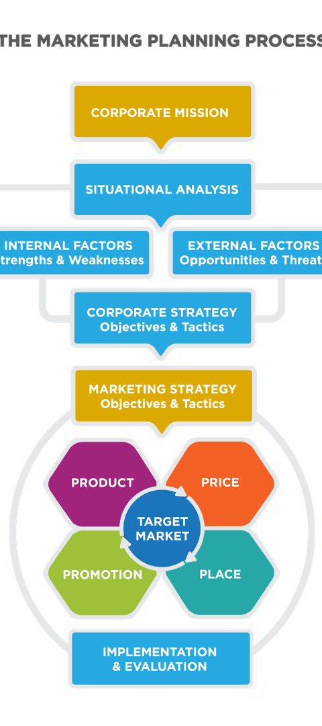



Marketing Strategy
Our approach to marketing and monetization is designed to rapidly expand our user base while increasing profitability.
Outreach
Engage with global church networks and Christian influencers.
Advertising
Targeted ads across social platforms to capture interest.
Subscriptions
Premium features for devoted users, ensuring steady revenue.

Slide 8

Conclusion and Call to Action
Join us in revolutionizing gospel media consumption. Be part of the movement connecting the world with the word of God.
Support Innovation
Spread the Word
Invest
Your partnership can transform gospel broadcasting.
Share the app with communities and increase its impact.
Opportunities for investment to scale operations and content.

Slide 9



Competitive Advantage
We provide an unmatched user experience with exclusive content and advanced personalization features.
User-Centric
Exclusive Content
Secure
User-friendly interface with cross-platform synchronicity.
Curated sermons and programs not found elsewhere.
Robust data protection and privacy for our users.

Slide 10

Traction & Road Map
See how our app has grown over time and the steps we're taking to ensure future success.
Launch
1
App launch and initial user acquisition phase.
2
Feedback
Iterative enhancements based on user feedback.
Expansion
3
Strategic partnerships to expand content offerings.

